Slide 1
BOOK SWAP COMMUNITY

Slide 2
INTRODUCTION TO BOOK SWAP COMMUNITY
Book swapping or book exchange is the practice of a swap of books between one person
and another. Practiced among book groups, friends and colleagues at work, it provides an
inexpensive way for people to exchange books, find out about new books and obtain a new
book to read without having to pay.

Slide 3
2. Type of users
Admin
Users

Slide 4
3. FUNCTIONAL REQUIREMENTS
USER LEVEL
User Authentication- register ,login
Book Management
Swap Management
Profile Management
ADMIN LEVEL
User Management
Book Management
Swap Management

Slide 5
4. Minimum Required Hardware Specifications
Server Hardware Specifications
Processor (CPU):
Intel Xeon E3-1230 v6 or equivalent (quad-core)
Memory (RAM):
16 GB DDR4
Storage:
500 GB SSD (Solid State Drive) for faster read/write operations

Slide 6
Client Hardware Specifications
Processor (CPU):
Dual-core processor
Memory (RAM):
4 GB RAM
Storage:
200 MB available disk space (for browser cache and temporary files)
Display:
1024x768 resolution

Slide 7
Minimum Software Specifications
Server Software Specifications
Software Specifications
Operating System:
Any modern OS such as Windows 10, macOS 10.15, Linux, iOS, or Android
Web Browser:
Google Chrome 88 or higher
Mozilla Firefox 85 or higher

Slide 8
Development Environment Specifications
Integrated Development Environment (IDE) / Code Editor:
Visual Studio Code
Sublime Text
Front-End Frameworks and Libraries:
Bootstrap 4 or 5 for responsive design and pre-designed components

Slide 9
5. PROCESS FLOW
Home Page
Home: The landing page that provides an overview of the application and its features.
Register: Registration page for new users to create an account.
Login: Login page for existing users to access their dashboard.
Swap book: All swapped books are view and listed
Contact: Page with contact information and a form for users to get in touch with support.

Slide 10
USER
User Authentication:
Register new users.
If username exists, system give message “Username already exists
Registered user details are stored in Registration table and username and password are stored in Login table
Password is encrypted using hashing algorithm and stored
Login and authenticate users.
If username and password matches with database values, login is authenticated
User is redirected to User Dashboard
The username is stored a SESSION VARIABLE to access it in all pages
Logout functionality
User is redirected either to Login page or to home page
Once LOGOUT button is clicked, user will not be able to go back to user dashboard using browser button

Slide 11
Book Management:
Add new books to the user's collection.
Users can add new books with all necessary details and stored in Book register table along with the logged in username.
While adding book details, book category is retrieved from book register table
View details of books in the collection.
All book details added by the current logged in user are displayed in a table format from the Add book table
Edit book details.
All book details added by the current logged in user are listed in a table format from the Add book table
An EDIT button is placed at the end of each row, so that user can edit required book details
On clicking the EDIT button, the book details of the selected row are automatically displayed in the form in another page
User can Edit the necessary details and store the updated details in the table

Slide 12
Delete books from the collection.
All books details added by the current logged in user are listed in a table format from the Add book table
A DELETE button is placed at the end of each row, so that user can delete the selected book details
On clicking the DELETE button, the book details of the selected row are automatically deleted.

Slide 13
Swap Management
Book Listing:
Explain how members list books for swapping.
Provide book details, condition, and preferred genres for swaps.
Request and Approval:
Detail the process for requesting and approving swaps.
Members request books through the platform and the system notifies the owner for approval.
Notifications:
Highlight how notifications are managed.
Automated notifications for swap requests, approvals, and reminders for meetings.

Slide 14
Account Settings:
View and update user profile information.
Using SESSION Variable user details are displayed from Registration Table , edit the details and update the table
Change user password.

Slide 15
2. ADMIN
Admin Functionalities:
Manage user accounts (view, edit, deactivate Users).
Manage book database (view, edit, delete book).
Manage swap requests (view swap, confirm swap).

Slide 16
6. Flow chart
Start
Book
Swap
user
Choose another name
Registration
process
yes
If
Username
Exist?
Input username , password
First name , last name,
mob no., email , address
Registration
table
no
Registration process store
details
Login
table

Slide 17
Login
process
start
Input username
password
Username
Or password
Not exist
If
Username
And password
match
no
Yes
Users dashboard

Slide 18
7. Data Flow Diagram
Context level DFD
User
details
admin
User details
Book swap
community
admin
Book
details
Registration
details
Book
details
user
user
Book
details
User
details

Slide 19
Level 1 : DFD book swapping user
Add book
Username
Book details
Book
management
List book
Book details
Book
table
Book id
username
Edit book
Delete book
Book id
user
Username
password
Login
process
Book details
Username
password
Swap
management
Username
password
username
Request swap
Profile
management
Swap request
table
Login
table
username
Confirm swap
Username
password
Edit profile
View profile
View registered books
Profile
table

Slide 20
Level 1 : DFD in book swap admin
View user
User
management
username
Login process
Edit user
username
User table
Admin
Username password
username
Delete user
Username
password
Book management
Login
table
Swap management
View books
Book table
Book table
Confirm swap
Book id
View swap request
Edit book
Book details
Delete book
Swap request table

Slide 21
8. Menu tree
Home page menus
home
Projects
Browse Project
All projects
Project category
Register
login
contact

Slide 22
User dashboard
User Profile
View Profile
Edit Profile
Projects
Create Project
All Projects
Project
Add Media
View
Edit
Delete
Logout

Slide 23
Admin dashboard
Users
View User
Edit User
Projects
View Projects
Add Category
Edit Projects
Logout
Delete Projects

Slide 24
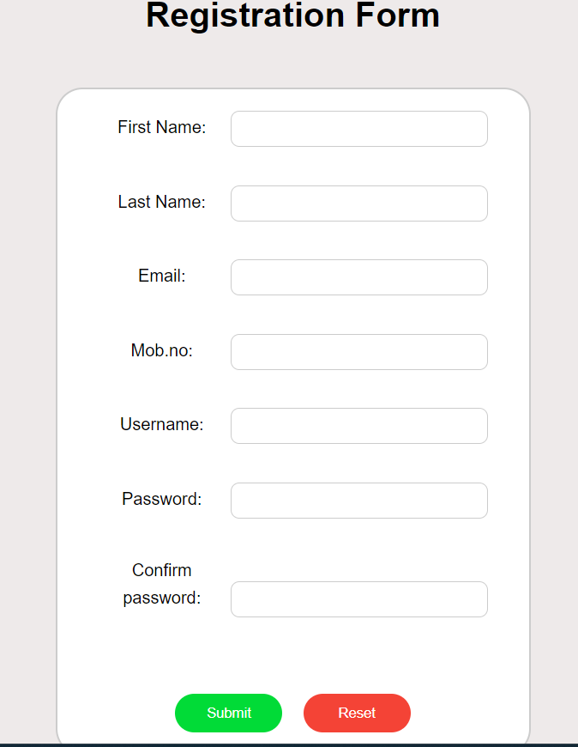
User registration form

Slide 25
9. Tables
User register Table
Sl. no | Field name | Field type | size | criteria
1. | First name | Text |  | Mandatory
2. | Last name | Text |  | Mandatory
3. | E mail | Text |  | Mandatory
4. | mob | Numeric | 10 | Mandatory
5. | username | Text |  | Mandatory
6. | password | Text |  | Mandatory

Slide 26
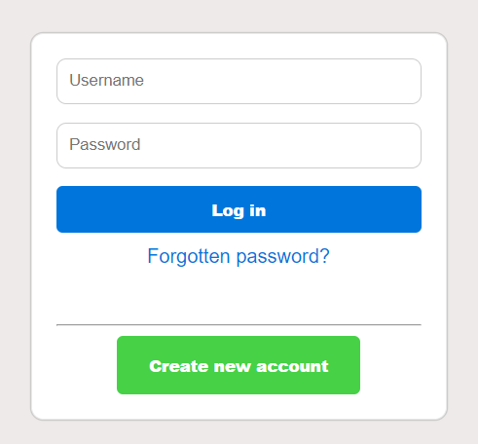
Login form

Slide 27
Login table design
Sl. no | Field name | Field type | size | criteria
1. | username | Text |  | mandatory
2. | password | Text |  | mandatory

Slide 28
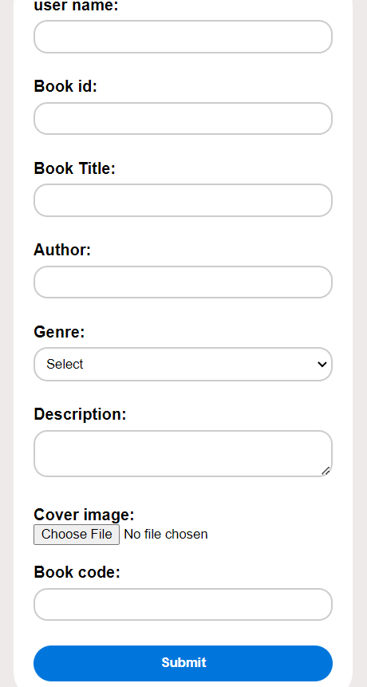
Book register form

Slide 29
Book registration table design
Sl. no | Field name | Field type | size | criteria
1. | Username | Text |  | Mandatory
2. | Book ID | Big int |  | Mandatory
3. | Book title | Text |  | Mandatory
4. | Author | Text |  | Mandatory
5. | Genre | Text |  | Mandatory
6. | Descriptions | Text |  | Mandatory
7. | Cover image | Bytea |  | Mandatory
8. | Book code | Character vary | 20s | Mandatory

Slide 30
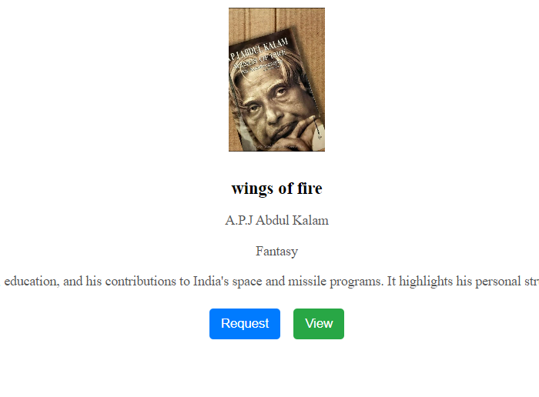
Initiate Swap request form

Slide 31
Book request table
Sl.no | Field name | Field type | size | criteria
1. | Request id | Integer |  | Mandatory
2. | Book owner | Char varying | 50 | Mandatory
3. | Requester | Char varying | 50 | Mandatory
4. | Request date | Date |  | Mandatory
5. | Book code | Char varying | 20 | Mandatory

Slide 32
10. E-R Diagram

